Slide 1

2023-24 NHL Shot Difficulty Study
Adam Bloodgood

Slide 2
Purpose of Study
Determine metrics from the 2023-24 NHL Season such as:
Who took the most difficult shots, on average.
Who scored the most difficult goals, on average.
Who shoots the best relative to their average shot difficulty.
Providing a weighted shooting percentage based on the players average shot difficulty.
Guidelines:
Pool of players studied will be those with at least 100 shots during the regular season.
When looking at goal metrics, only forwards with at least 20 goals will be considered, and defensemen with at least 10 goals will be considered.
Empty net goals will not be included in calculations.
Difference From Other Metrics:
Goals Above Expected: A metric for a player over the course of an entire season. This study is meant to gauge player skill on a per shot basis. Goals Above Expected is also skewed by the ice time a player gets.
Adam Bloodgood

Slide 3
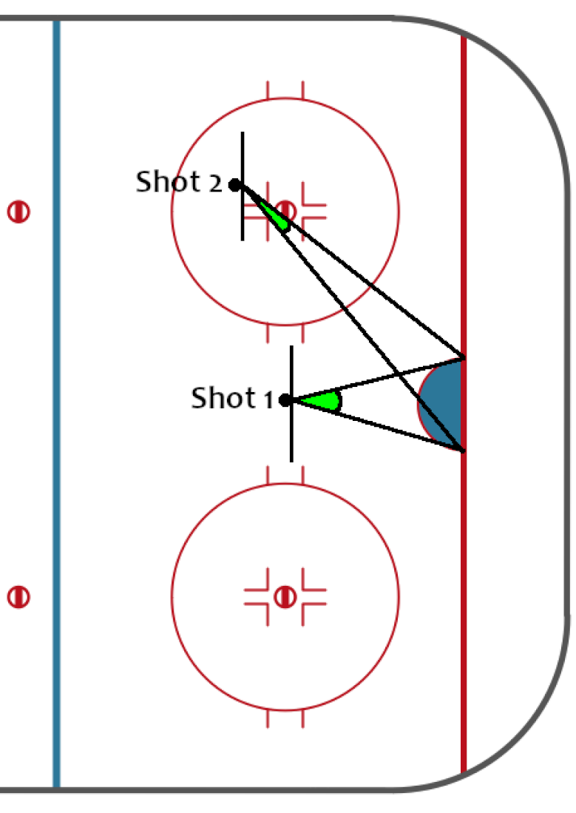
How It’s Calculated: Shot Difficulty
Shot difficulty is calculated by the angle margin of error the player has when shooting the puck, in order for it to be on net.
The idea is that shots that are further or angled away from the net are more difficult.
Ex: Shot 2 is both further and angled away from the net more than Shot 1. Meaning that the angle margin of error for the shot is more than Shot 1. Therefore, Shot 2 is more difficult.
Adam Bloodgood

Slide 4
How It’s Calculated: Shot Difficulty
FORMULA: (π - (angle margin in radians)) / π
Shot with 30° angle margin: (π - (π/6)) / π = .833 difficulty
Shot with 45° angle margin: (π - (π/4)) / π = .75 difficulty
Shot with 60° angle margin: (π - (π/3)) / π = .666 difficulty
Shots from or behind the goal line outside the posts and <=0° angle margin have a difficulty of 1
Shots from the goal line inside the posts and 180° angle margin have a difficulty of 0
(Including elevation angle margins in calculations resulted in shot difficulty dropping off too quickly from close to long ranges and angles. Therefore, elevation angles were not included)
Adam Bloodgood

Slide 5
How It’s Calculated:
Adjusted Shooting Percentage (AS%)
An adjusted/weighted shooting percentage will be calculated as:
(Avg. Shot Difficulty) * Shooting%
Those with a .1 shooting percentage and an average shot difficulty of .9 will have a higher AS% (.09) than someone with a .12 shooting percentage and an average shot difficulty of .7 (AS% = .084).
This benefits the AS% of those who shoot from further away (i.e. Defensemen)
Adam Bloodgood

Slide 6
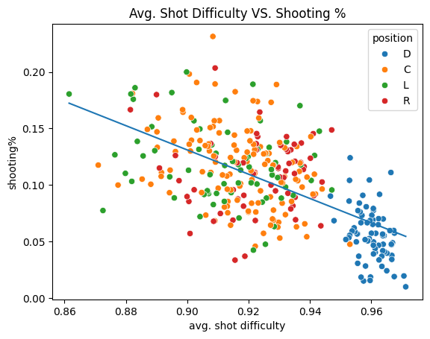
How It’s Calculated:
Expected Shooting % (xS%)
Expected Shooting % is calculated using linear regression based on the relationship between a players Avg. Shot Difficulty and their Shooting%.
From there, calculated each player’s Shooting% Above Expected.
The higher above the line-of-best fit, the better the player’s Shooting% Above Expected and vice versa.
Adam Bloodgood

Slide 7
Shot Difficulty (Forwards vs Defensemen)
Forwards:
mean 0.917000
std 0.016576
min 0.861488
25% 0.907389
50% 0.919558
75% 0.929586
max 0.953063
Defensemen:
mean 0.960157
std 0.005015
min 0.946731
25% 0.956592
50% 0.960549
75% 0.963788
max 0.971268
Adam Bloodgood

Slide 8
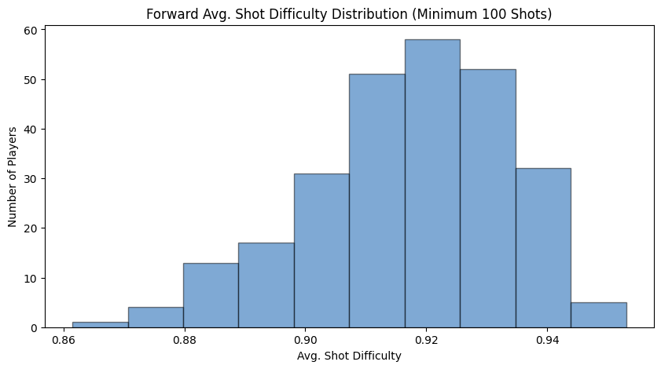
Top Forwards in Avg. Shot Difficulty
(min. 100 shots)
Top 5 (Most difficult):
Frederick Gaudreau (0.953063)
Nikolaj Ehlers (0.947168)
Dylan Guenther (0.947124)
Adam Fantilli (0.944001)
Oliver Bjorkstrand (0.943977)
Bottom 5 (Least Difficult):
Zach Hyman (0.861488)
Alex Kerfoot (0.870994)
James van Riemsdyk (0.872529)
Dmitri Voronkov (0.876415)
Nicolas Roy (0.877445)
Adam Bloodgood

Slide 9
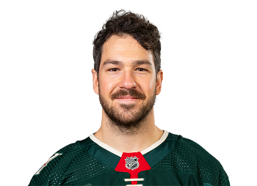
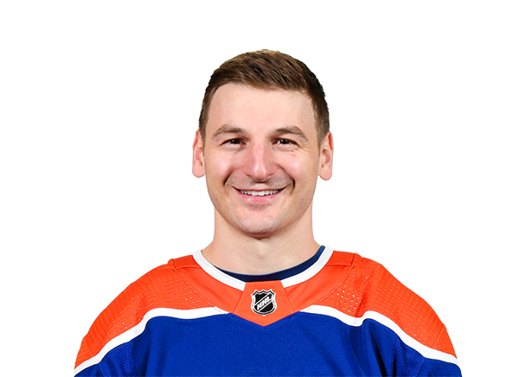
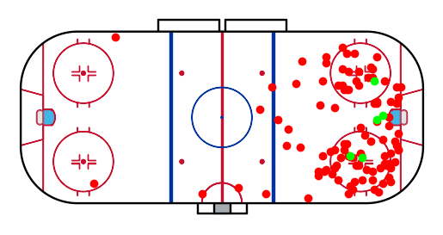
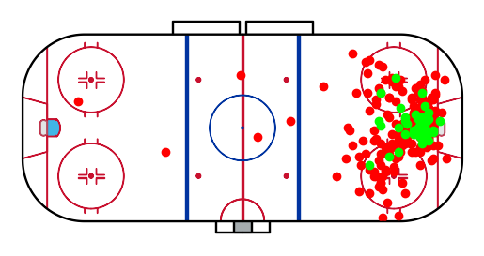
Forward Comparison
Frederick Gaudreau (C, MIN):
Avg. SD: 0.953, Avg. GD: 0.899
Goals: 5, Shots: 105
xS%: 7.41, S%: 4.76 (-35.8%)
AS%: 4.54
S% Rank: 310, AS% Rank: 311 (-1)
Zach Hyman (LW, EDM):
Avg. SD: 0.861, Avg. GD: 0.817
Goals: 52, Shots: 288
xS%: 17.24, S%: 18.06 (+4.7%)
AS%: 15.55
S% Rank: 14, AS% Rank: 21 (-7)
Adam Bloodgood

Slide 10
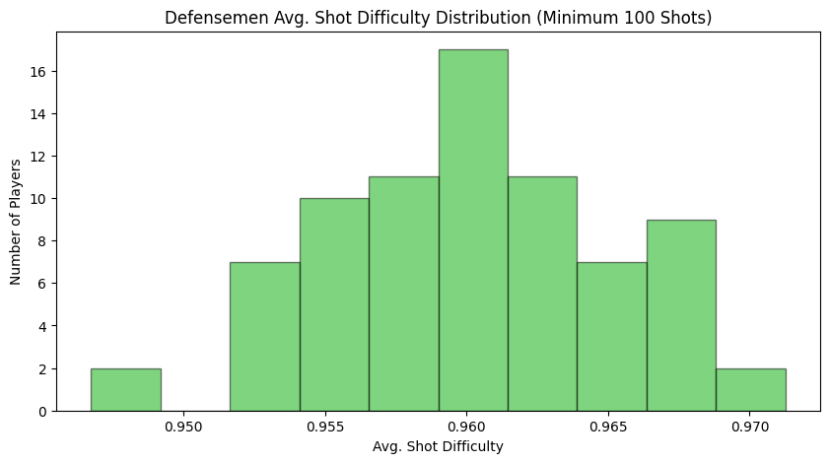
Top Defensemen in Avg. Shot Difficulty
(min. 100 shots)
Top 5 (Most Difficult):
Nick Seeler (0.971268)
Ryan Suter (0.970674)
Noah Dobson (0.967590)
Nicolas Hague (0.967522)
Alexander Romanov (0.967365)
Bottom 5 (Least Difficult):
Charlie McAvoy (0.946731)
Travis Sanheim (0.947878)
Brock Faber (0.951741)
Cam York (0.952726)
Roman Josi (0.952806)
Adam Bloodgood

Slide 11
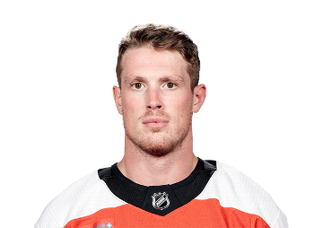
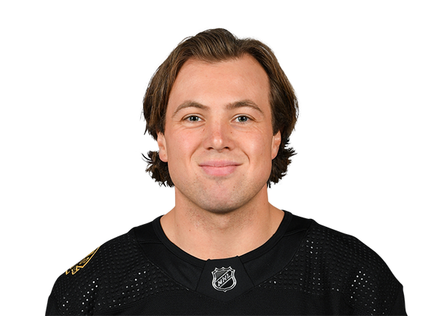
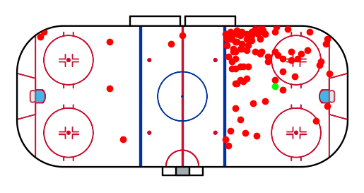
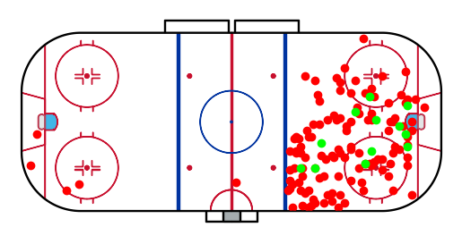
Defensemen Comparison
Nick Seeler (D, PHI):
Avg. SD: 0.971, Avg. GD: 0.944
Goals: 1, Shots: 100
xS%: 5.46, S%: 1.00 (-81.7%)
AS%: 0.97
S% Rank: 340, AS% Rank: 340
Charlie McAvoy (D, BOS):
Avg. SD: 0.946, Avg. GD: 0.919
Goals: 12, Shots: 133
xS%: 8.09, S%: 9.02 (+11.5%)
AS%: 8.54
S% Rank: 213, AS% Rank: 203 (+10)
Adam Bloodgood

Slide 12
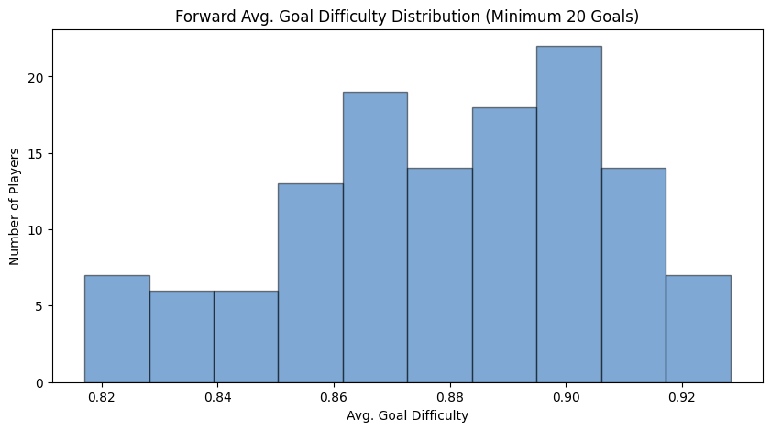
Top Forwards in Avg. Goal Difficulty
(min. 20 goals)
Top 5 (Most Difficult):
William Nylander (0.928351)
Steven Stamkos (0.927118)
Jeff Skinner (0.923787)
Bo Horvat (0.923152)
Alex DeBrincat (0.921131)
Bottom 5 (Least Difficult):
Zach Hyman (0.817050)
Adam Henrique (0.818431)
Boone Jenner (0.822282)
Kyle Palmieri (0.822531)
Tyler Bertuzzi (0.825690)
Adam Bloodgood

Slide 13
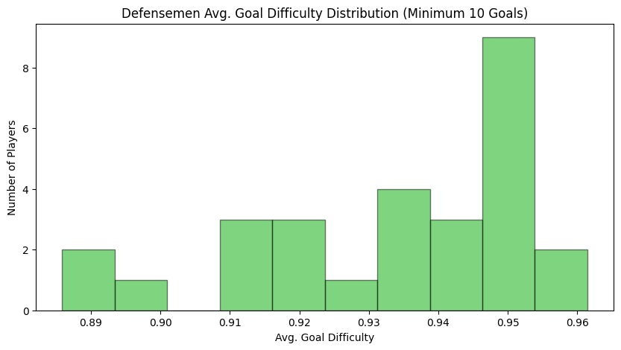
Top Defensemen in Avg. Goal Difficulty
(min. 10 goals)
Top 5 (Most Difficult):
Erik Karlsson (0.966645)
Quinn Hughes (0.955919)
Vince Dunn (0.951812)
Jake Walman (0.951753)
MacKenzie Weegar (0.950823)
Bottom 5 (Least Difficult):
Mike Matheson (0.885883)
Thomas Harley (0.889916)
Travis Sanheim (0.894902)
Brady Skjei (0.910000)
Josh Morrissey (0.911054)
Adam Bloodgood

Slide 14
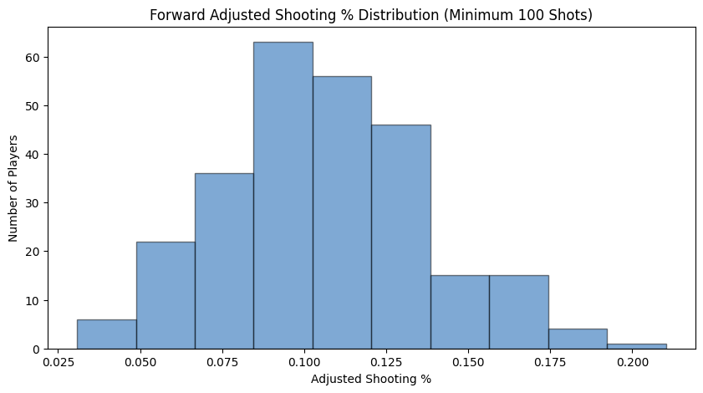
Top Forwards in Adjusted Shooting %
(min. 100 shots)
Top 5 (Best Shooters):
Sam Reinhart (21.02%)
Anthony Mantha (18.50%)
Nils Hoglander (18.00%)
Brayden Point (17.85%)
Leon Draisaitl (17.55%)
Bottom 5 (Worst Shooters):
Taylor Raddysh (3.08%)
Connor Brown (3.40%)
Miles Wood (3.91%)
Noah Gregor (4.23%)
Anthony Beauvillier (4.41%)
Adam Bloodgood

Slide 15
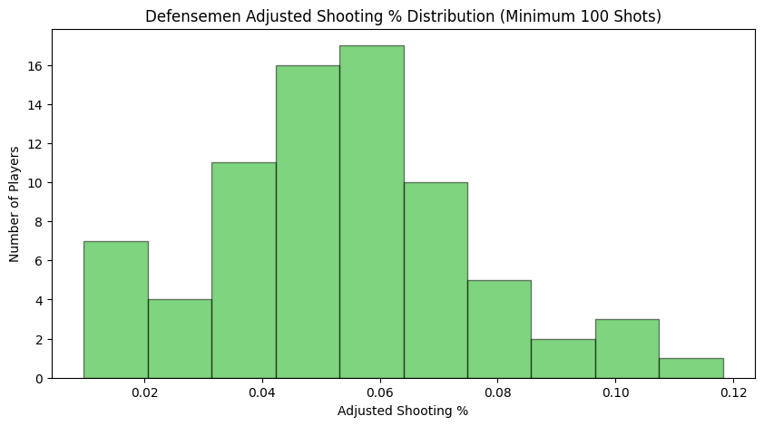
Top Defensemen in Adjusted Shooting %
(min. 100 shots)
Top 5 (Best Shooters):
Adam Fox (11.83%)
Jake Walman (10.74%)
Drew Doughty (10.00%)
Thomas Harley (9.93%)
MacKenzie Weegar (8.84%)
Bottom 5 (Worst Shooters):
Nick Seeler (0.97%)
Justin Faulk (1.45%)
Jacob Trouba (1.50%)
Jamie Oleksiak (1.77%)
Torey Krug (1.79%)
Adam Bloodgood

Slide 16
Adjusted Shooting % Findings
Kept track of each players ranking among all 340 qualified players in shot% as well as ASP.
The average forward (264 total) went down 0.78 spots in rank from shot% to ASP.
The average defenseman (76 total) went up 2.73 spots in rank from shot% to ASP.
Biggest Risers:
Jake Walman (+17)
MacKenzie Weegar (+17)
Adam Fox (+16)
Drew Doughty (+15)
Jared McCann (+13)
Biggest Fallers:
Nick Foligno (-20)
Dmitri Voronkov (-18)
Jaden Schwartz (-17)
Artturi Lehkonen (-17)
Alex Kerfoot (-15)
Adam Bloodgood

Slide 17
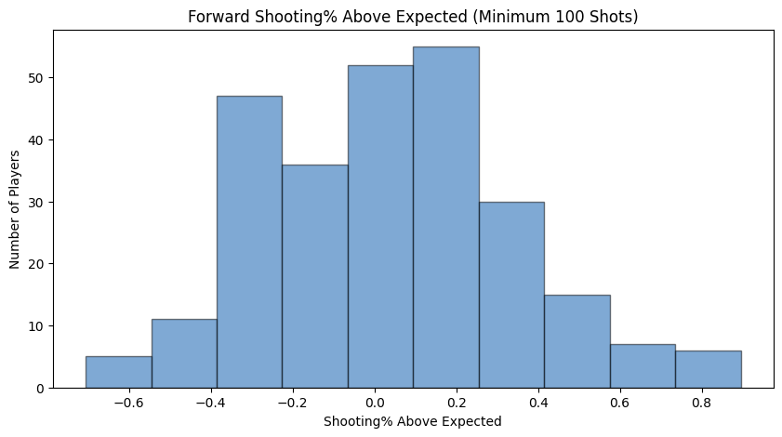
Top Forward Expected Shooting %
(min. 100 shots)
Top 5 (Most Efficient):
Sam Reinhart (+89.6%)
Leon Draisaitl (+89.3%)
Teuvo Teravainen (+85.8%)
Dylan Guenther (+84.7%)
Michael Carcone (+75.1%)
Bottom 5 (Least Efficient):
Taylor Raddysh (-70.6%)
Connor Brown (-66.6%)
Miles Wood (-60.7%)
Noah Gregor (-57.2%)
Josh Anderson (-56.1%)
The average forward (264 total) shot 3.9% better relative to their expected shooting %.
Adam Bloodgood

Slide 18
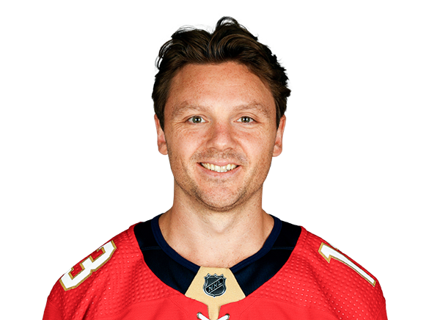
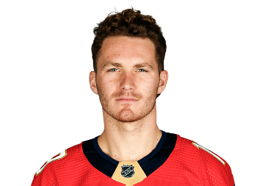
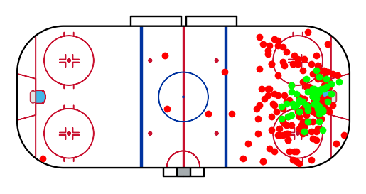
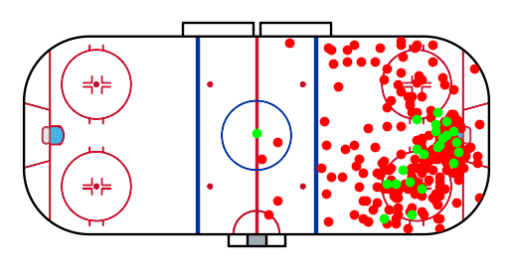
Forward Comparison
Sam Reinhart (C, FLA):
Avg. SD: 0.908, Avg. GD: 0.87
Goals: 53, Shots: 229
xS%: 12.21, S%: 23.14 (+89.57%)
AS%: 21.02
S% Rank: 1, AS% Rank: 1
Matthew Tkachuk (LW, FLA):
Avg. SD: 0.909, Avg. GD: 0.882
Goals: 23, Shots: 278
xS%: 12.19, S%: 8.27 (-32.14%)
AS%: 7.52
S% Rank: 232, AS% Rank: 235 (-3)
Adam Bloodgood

Slide 19
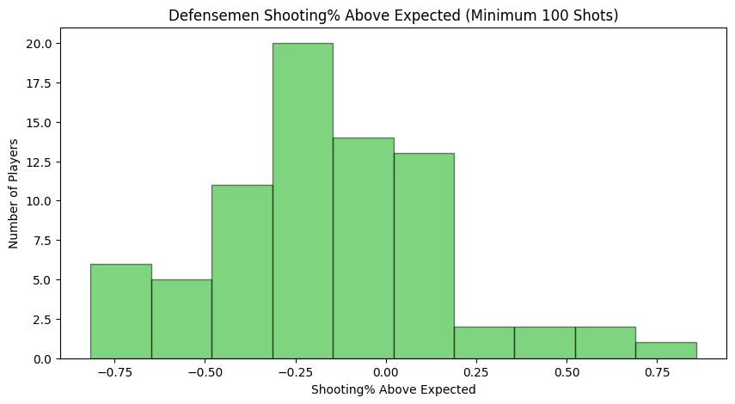
Top Defensemen Expected Shooting %
(min. 100 shots)
Top 5 (Most Efficient):
Jake Walman (+85.9%)
Adam Fox (+67.6%)
Drew Doughty (+55.2%)
MacKenzie Weegar (+44.0%)
Thomas Harley (+40.3%)
Bottom 5 (Least Efficient):
Nick Seeler (-81.7%)
Justin Faulk (-78.2%)
Jacob Trouba (-76.7%)
Jamie Oleksiak (-73.6%)
Torey Krug (-72.2%)
The average defenseman (76 total) shot 16.6% worse relative to their expected shooting %.
Adam Bloodgood

Slide 20
Expected Shooting % Findings
We can attribute forwards (on average) shooting better than expected to a few factors:
Shots in close may be due to plays where the goaltender is out of position such as rebounds, odd-man rushes, one-timers, tip-ins, deflections, etc.
Forwards are more likely to get breakaways which greatly increase their odds of scoring due to the extra time and space.
Forwards are known for their scoring ability more than defensemen.
We can attribute defensemen (on average) shooting worse than expected to a few factors:
Shots from the point where the goalie has a clear line of sight are much easier to stop.
Defensemen may be intentionally shooting low for rebounds to generate secondary scoring opportunities.
Defensemen are typically not considered the best shooters on their teams and the more offensive ones are usually well known for their playmaking ability.
We can expect players, like Sam Reinhart and Matthew Tkachuk, who have proven track records, to regress (positively or negatively) closer to their career averages next season, due to over/underperformance relative to their peers.
Adam Bloodgood

